Slide 1
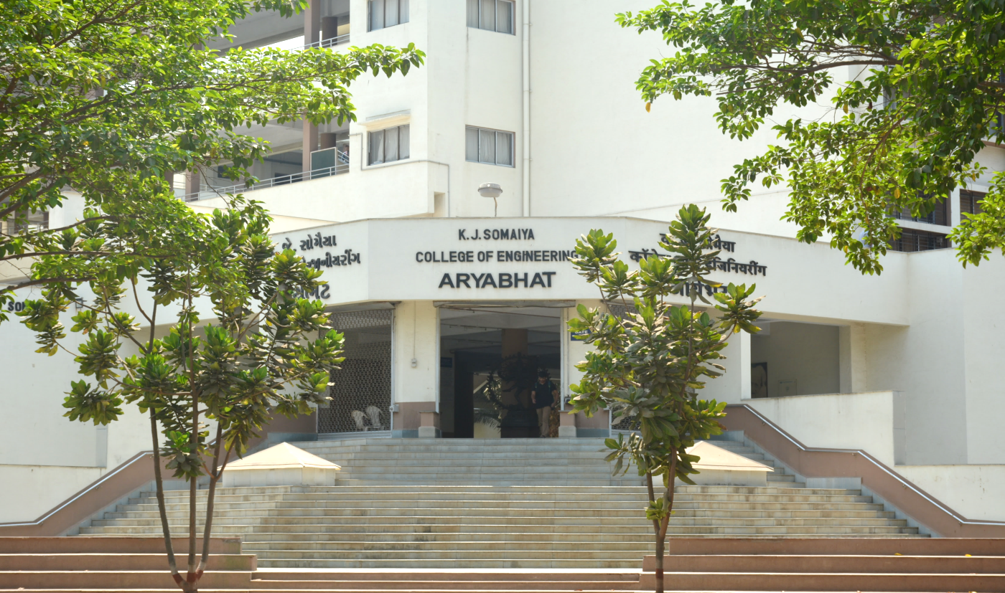
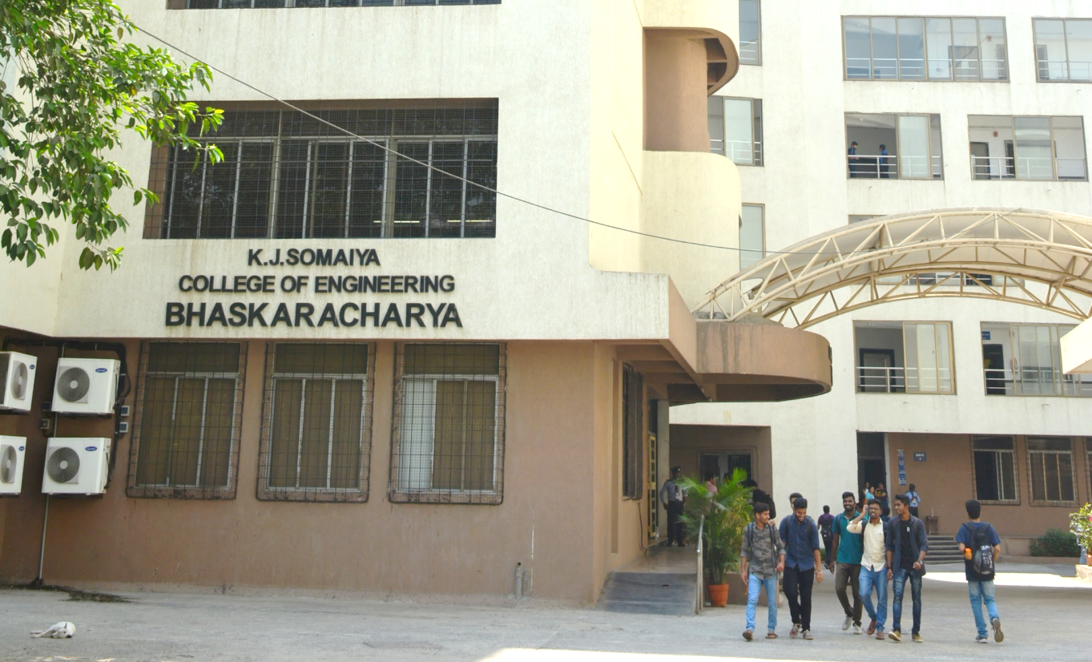
OOPM
*
1

Slide 2
Module 3
Inheritance
Types of Inheritance
Polymorphism
Method overloading
Method Overriding
Final class and Method
Abstract class
Interface
*
2
Notes:
2

Slide 3
What is Inheritance
The mechanism of deriving a new class from an old one is called inheritance
The old class is known as the base class or super class
The new class is known as the subclass or derived class or child class
*
3

Slide 4
Types of inheritance
Single inheritance(only super class)
Heirarchical inheritance(one super class,many subclasses)
Multilevel inheritance(derived from a derived class)
Multiple inheritance(many superclasses) implemented in the form of interface
*
4

Slide 5
Syntax to inherit a class
class subclass-name extends superclass-name
{
//body of class
}
*
5

Slide 6
Example
class Parent {
void show() {
System.out.println("This is the parent class.");
}
}
class Child extends Parent {
void display() {
System.out.println("This is the child class.");
}
}
public class Main {
public static void main(String[] args) {
Child c = new Child();
c.show(); // inherited from Parent
c.display(); // own method
}
}
*
6

Slide 7
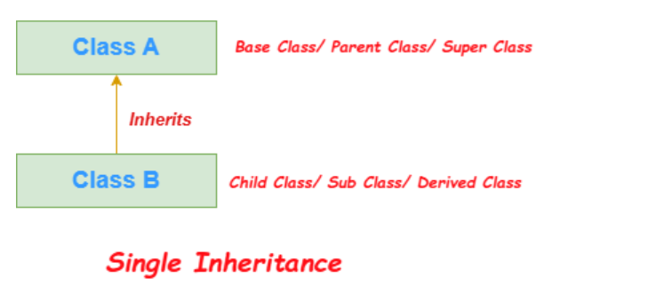
Single Inheritance
When a class inherits another class, it is known as a single inheritance.
*
7

Slide 8
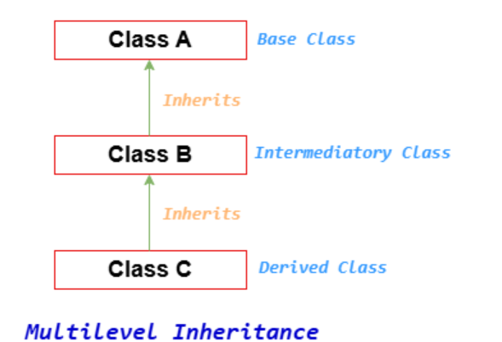
Multilevel Inheritance
When there is a chain of inheritance, it is known as multilevel inheritance.
*
8

Slide 9
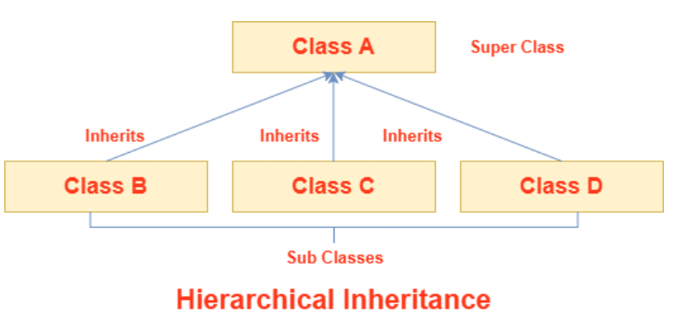
Hierarchical Inheritance
When two or more classes inherits a single class, it is known as hierarchical inheritance.
*
9

Slide 10
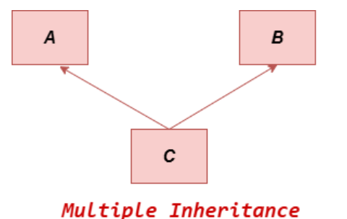
Multiple Inheritance
A class's capacity to inherit traits from several classes is referred to as multiple inheritances. This notion may be quite helpful when a class needs features from many sources.
Multiple inheritances, however, can result in issues like the diamond problem, which occurs when two superclasses share the same method or field and causes conflicts.
Suppose there are three classes A, B, and C. The C class inherits A and B classes. If A and B classes have the same method and we call it from child class object, there will be ambiguity to call the method of A or B class. It is called diamond problem.
Java uses interfaces to implement multiple inheritances in order to prevent these conflicts.
*
10

Slide 11
Single Inheritance
class Vehicle {
void startEngine() {
System.out.println("Engine started.");
}
}
class Car extends Vehicle {
void drive() {
System.out.println("Car is driving.");
}
}
public class Main {
public static void main(String[] args) {
Car car = new Car();
car.startEngine(); // Inherited from Vehicle
car.drive(); // Car's own method
}
}
*
11

Slide 12
Multilevel Inheritance
class Vehicle {
void startEngine() {
System.out.println("Engine started.");
}
}
class Car extends Vehicle {
void drive() {
System.out.println("Car is driving.");
}
}
class ElectricCar extends Car {
void chargeBattery() {
System.out.println("Battery is charging.");
}
}
public class Main {
public static void main(String[] args) {
ElectricCar eCar = new ElectricCar();
eCar.startEngine(); // from Vehicle
eCar.drive(); // from Car
eCar.chargeBattery(); // from ElectricCar
}
}
*
12

Slide 13
Hierarchical Inheritance
class Vehicle {
void startEngine() {
System.out.println("Engine started.");
}
}
class Car extends Vehicle {
void drive() {
System.out.println("Car is driving.");
}
}
class Truck extends Vehicle {
void loadCargo() {
System.out.println("Truck is loading cargo.");
}
}
public class Main {
public static void main (String[] args) {
Car car = new Car();
car.startEngine();
car.drive();
Truck truck = new Truck();
truck.startEngine();
truck.loadCargo();
}
}
*
13

Slide 14
Super Keyword
super is a reference keyword in Java used to refer to the immediate parent class object.
It is mainly used in inheritance.
There are 3 primary uses:
Call parent class constructor
Access parent class variable
Call parent class method
*
14

Slide 15
Call parent class constructor
Used when child wants to initialize parent properties.
class Shape {
String color;
Shape(String color) {
this.color = color;
}
}
class Circle extends Shape {
double radius;
Circle(String color, double radius) {
super(color); // calls Shape constructor
this.radius = radius;
}
}
*
15

Slide 16
Access Parent Class Variable
Used when parent and child have same variable name.
class Parent {
String name = "Parent";
}
class Child extends Parent {
String name = "Child";
void display() {
System.out.println(name); // Child
System.out.println(super.name); // Parent
}
}
class Super_param
{
public static void main(String args[])
{
Child c=new Child();
c.display();
}
}
*
16

Slide 17
Call Parent Class Method
Used when child overrides a method but still wants parent logic..
class Parent {
void show() {
System.out.println("Parent method");
}
}
class Child extends Parent {
void show() {
super.show(); // calls parent method
System.out.println("Child method");
}
}
class Super_method
{
public static void main(String args[])
{
Child c=new Child();
c.show();
}
}
*
17

Slide 18
Constructor Chaining Diagram
Child() constructor
↓
super() → Parent() constructor
↓
Initialize parent data
↓
Return to Child()
↓
Initialize child data
*
18

Slide 19
Topics related to polymorphism
Method overriding
Abstract method
Interface(multiple inheritance)
Final keyword
*
19

Slide 20
Method overriding
In a class hierarchy, when a method in a subclass has the same name and type signature as a method in its superclass, then the method in the subclass is said to override the method in the superclass.
*
20

Slide 21
Abstract class
Abstract class is a class wherein you only define the methods and the actual implementation is in the derived class
No objects can be created for the abstract class
The keyword used is abstract
The subclass derived from the abstract class must implement all the abstract methods
Abstract constructors and static methods cannot exist
*
21

Slide 22
Final keyword
It is used to create equivalent of constants
Methods declared cannot be overriden
Class declared as final cannot be inherited
*
22

Slide 23
Simple program that demonstrates final keyword
final class Vehicle { // Final class cannot be extended
final int speedLimit = 100; // Final variable (constant)
final void displaySpeed() { // Final method cannot be overridden
System.out.println("Speed limit is: " + speedLimit + " km/h");
}
}
// Trying to extend Vehicle will give an error
// class Car extends Vehicle { } // ❌ Not allowed
class CarExample {
public static void main(String[] args) {
Vehicle v = new Vehicle();
// Accessing final variable
v.displaySpeed();
// v.speedLimit = 120; // ❌ Error: cannot assign a value to final variable
}
}
*
23

Slide 24
Method Overloading
Method overloading means having multiple methods with the same name in a class but different parameter lists.
The compiler decides which method to call based on the number and type of arguments.
It is an example of compile-time polymorphism.
*
24

Slide 25
Polymorphism
The word polymorphism means "many forms".
In Java, polymorphism allows the same method or object to behave differently in different contexts.
There are two types of polymorphism:
Compile-time polymorphism (Method Overloading)
Decided at compile time.
Achieved by method overloading.
Runtime polymorphism (Method Overriding)
Decided at runtime.
Achieved by method overriding + inheritance + dynamic method dispatch.
*
25

Slide 26
Interface
An interface in Java is like a blueprint of a class.
It contains only abstract methods.
Keyword used is implement
A class must implement an interface to provide the method definitions.
Multiple inheritance is possible in Java using interfaces.
*
26

Slide 27
// First interface
interface Printer {
void print(String document);
}
// Second interface
interface Scanner {
void scan(String document);
}
// Class implements multiple interfaces
class MultiFunctionMachine implements Printer, Scanner {
@Override
public void print(String document) {
System.out.println("Printing: " + document);
}
@Override
public void scan(String document) {
System.out.println("Scanning: " + document);
}
}
*
27

Slide 28
// Main class
public class Interface_2{
public static void main(String[] args) {
MultiFunctionMachine mfm = new MultiFunctionMachine();
// Using as Printer
Printer p = mfm;
p.print("Report.pdf");
// Using as Scanner
Scanner s = mfm;
s.scan("Invoice.png");
}
}
Shows multiple interface implementation
(Java allows this unlike multiple inheritance of classes).
Demonstrates polymorphism:
the same object mfm can be treated as a Printer or a Scanner.
*
28

Slide 29
Early vs Late Binding in Java
Binding = Linking a method call to its method body.
Two types:
• Early Binding (Static Binding)
• Late Binding (Dynamic Binding)
*
29

Slide 30
Early Binding (Static Binding)
Occurs at Compile Time.
Method call is resolved before execution.
Used in:
• Method Overloading
• Static Methods
• Final Methods
• Private Methods
*
30

Slide 31
Example – Early Binding
class Test {
void show(int a) {}
void show(String s) {}
}
Test t = new Test();
t.show(10);
Compiler decides method → Compile Time
*
31

Slide 32
Late Binding (Dynamic Binding)
Occurs at Runtime.
Method call is resolved during execution.
Used in:
• Method Overriding
• Runtime Polymorphism
• Non‑static Methods
*
32

Slide 33
Example – Late Binding
class Animal {
void sound() {
System.out.println("Animal sound");
}
}
class Dog extends Animal {
void sound() {
System.out.println("Dog barks");
}
}
public class Main {
public static void main(String[] args)
{
Animal a = new Dog();
a.sound(); // decided at runtime
}
}
Reference → Animal
Object → Dog
Method decided at Runtime
*
33

Slide 34
Early vs Late Binding – Difference
Early Binding:
• Compile Time
• Faster
• Overloading
Late Binding:
• Runtime
• More Flexible
• Overriding
*
34

Slide 35
Early vs Late Binding Comparison Table
Feature | Early Binding | Late Binding
Also Called | Static Binding | Dynamic Binding
Decision Time | Compile Time | Runtime
Polymorphism Type | Compile-time | Runtime
Method Type | Overloading, Static, Final, Private | Overriding
Flexibility | Less Flexible | More Flexible
*
35

Slide 36
Garbage collector
The Java runtime environment has a garbage collector that periodically frees the memory used by objects that are no longer needed.
Two basic approaches used by garbage collectors are
Reference counting
Tracing.
Reference counting
It maintains a reference count for every object.
A newly created object will have count as 1.
Throughout its lifetime, the object will be referred to by many other object thus incrementing the reference count.
As the referencing object move to other objects, the reference count for that particular object is decremented.
When reference count for a particular object is 0, the object can be garbage collected.
*
36

Slide 37
Garbage collector
Tracing
This technique traces the entire set of objects (starting from root) and all objects having reference on them are marked in some way.
Tracing garbage collector algorithm popularly known as is mark and sweep garbage collector scans Java’s dynamic memory areas for objects, marking those objects that are referenced.
After all the objects are investigated, the objects that are not marked (not referenced) are assumed to be garbage and their memory is reclaimed.
Mark and sweep collectors further use the techniques of Compaction and Copying for fragmentation problems that may arise once you sweep the unreferenced objects.
Compaction moves all the live objects towards one end making the other end a large free space.
Copying techniques copies all live objects besides each other into a new space and the old space is considered free now.
*
37

Slide 38
Garbage collector
The garbage collector runs either synchronously or asynchronously in a low priority daemon thread.
The garbage collector executes synchronously when the system runs out of memory or asynchronously when the system is idle.
The garbage collector can be invoked to run at any time by calling System.gc() or Runtime.gc().
But asking the garbage collector to run does not guarantee that your objects will be garbage collected.
*
38

